Slide 1
Injection Molding Tooling
JACO Manufacturing
468 Geiger Street, Berea Ohio 44017

Slide 2
Custom Molding Tooling
  Custom Molding Tooling consists of a variety of different components that make up each tool. These components are carefully crafted specifically for each part being made- creating a custom made mold. Diving deeper into the makeup of an Injection Mold, it is important to understand the different elements, and how their roles contribute to creating each plastic part.

Slide 3
INJECTION MOLDING PROCESS
Material runs through entrance point
Fills Part Cavity
Enters Sprue
Continues to Runner System
Flows through Gate
Cavity cools/ gate freezes off to prepare ejection
Mold opens/ Part is ejected after cooling

Slide 4
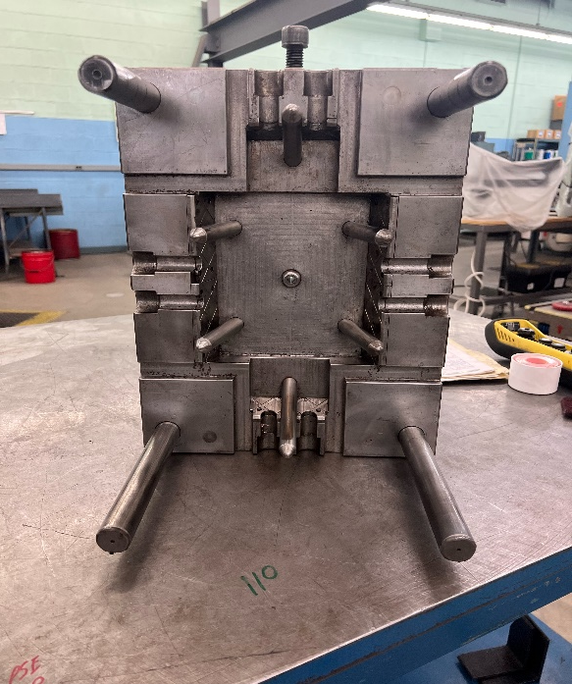
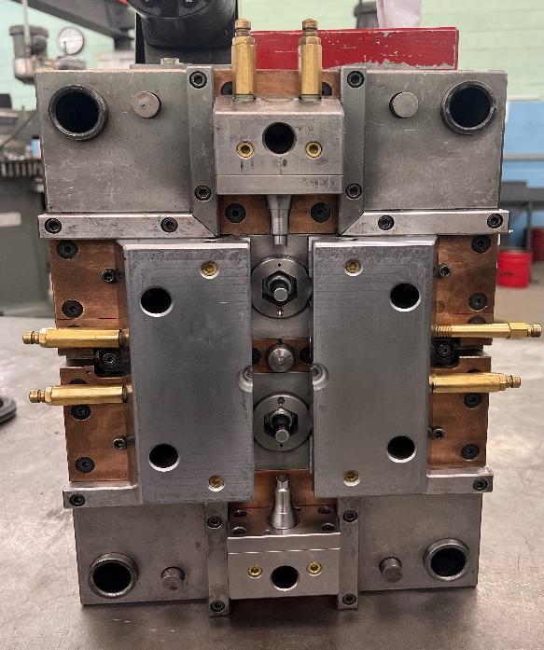
Mold design
Stationary Half: Known as the injection half of the custom mold, the stationary half consists of components that contribute to the injection of the plastic
Moving Half: Often referred to as the ejection half, holds all ejector components in order to remove the part from the mold at the end of the cycle.

Slide 5
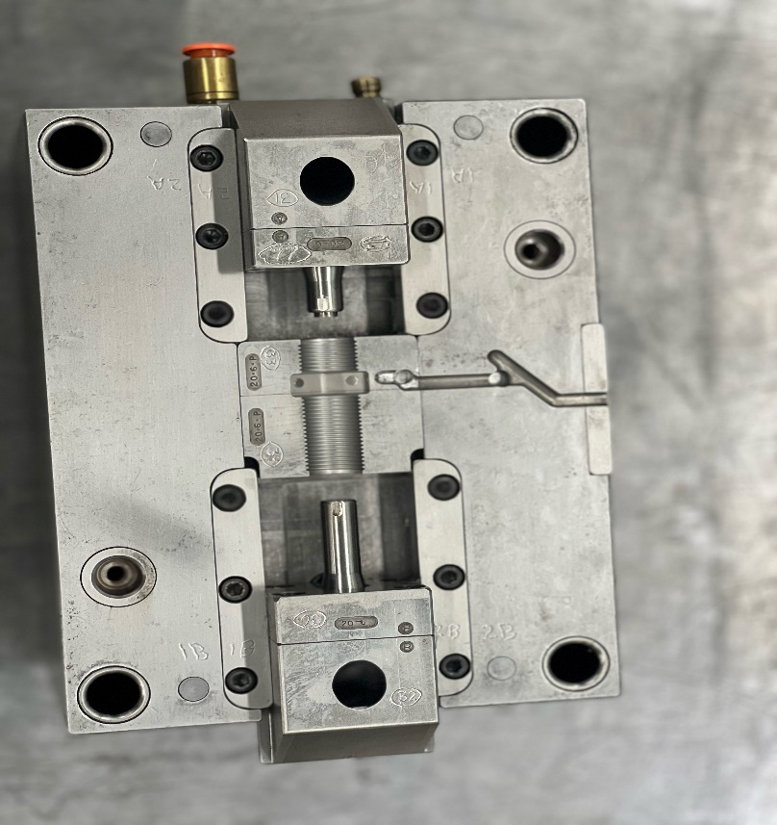
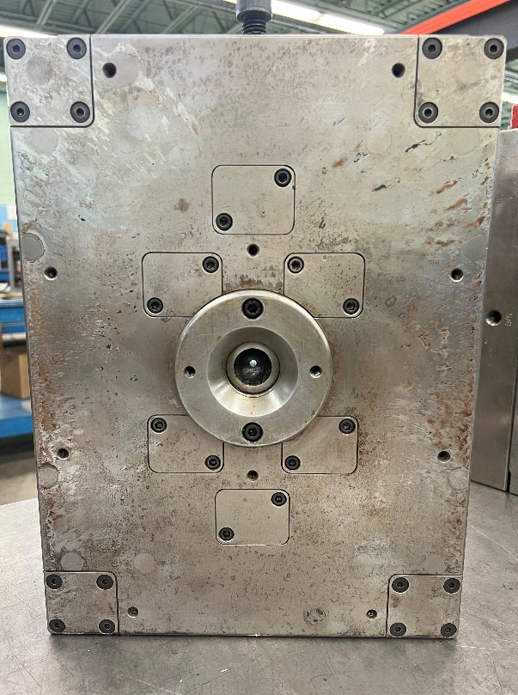
How plastic enters the mold
Sprue: Where the material enters the mold and starts the runner system
Runner: This is the path required to get molten plastic to the gates. In a cold runner mold this becomes either regrind or scrap material. In a hot runner mold, this material stays molten and will be used in the next shot; the hot runner process creates little to no regrind or scrap material.
Cold Slugs: These are used to trap the coolest portion of the runner so that it does not interfere with filling the cavities.
Runner
Cold Slug
Sprue

Slide 6
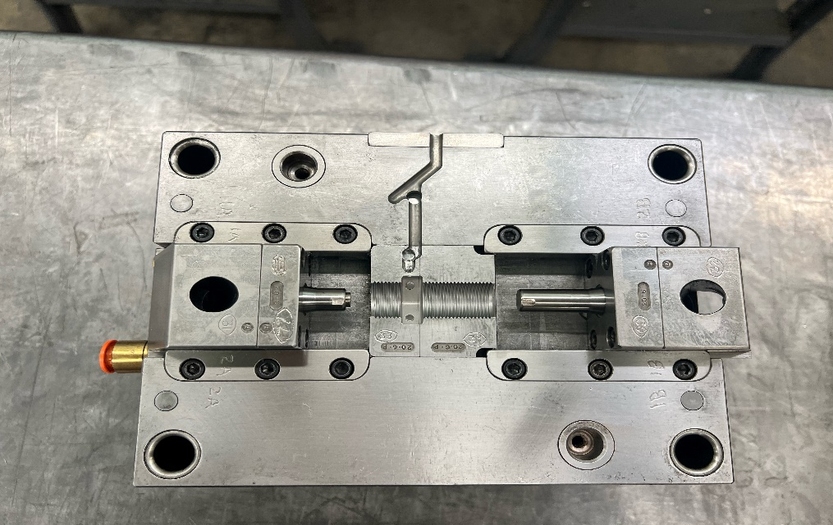
where the part is formed
Cavity Block
GATE: This is how the material flows into the cavity detail.
CAVITY BLOCK: Forms each products external surface
CORE: Forms the internal surface of each part when needed in conjunction with the cavity block
Gate
Core

Slide 7

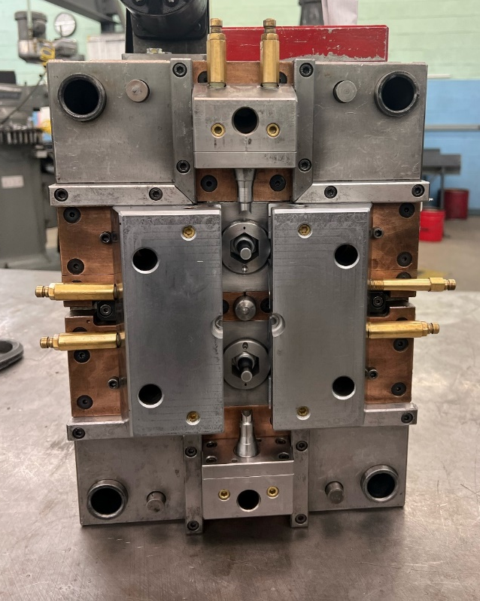
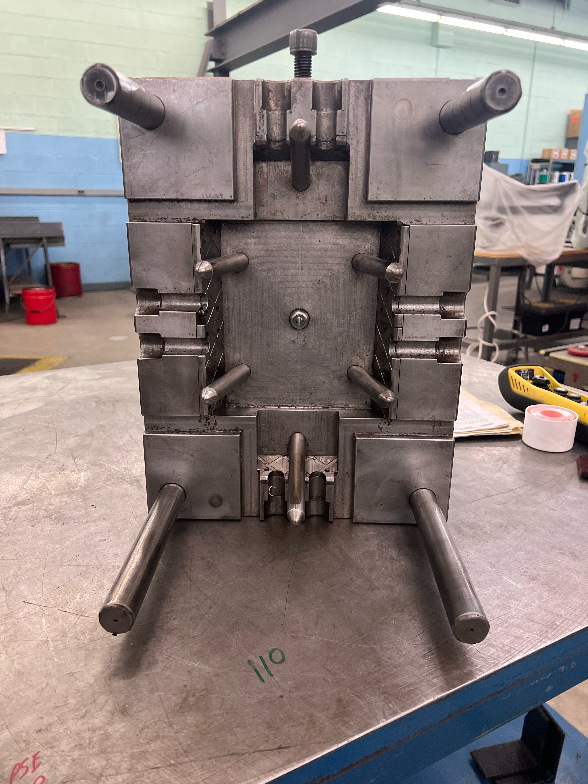
where the part is formed
Horn Pins
Slides: A side action within the tool is used for a part that needs an undercut or side hole
Horn or Angle pins: These are used to move a slide that would create a side hole or undercut feature on a part
Slides

Slide 8

Venting & Temperature
During Molding
Venting: This is a very thin opening on the outside of the cavity blocks to allow gas to escape to prevent voids and burning
Cooling lines: These maintain the proper mold temperature necessary for part finish and to prevent warping. These include water lines or oil lines and are chosen based on required steel temperatures.
Insulator Boards: These are on the outside of the tool and help maintain consistent heat that is needed in the mold in order to create parts based on processing parameters.
Cooling Lines

Slide 9
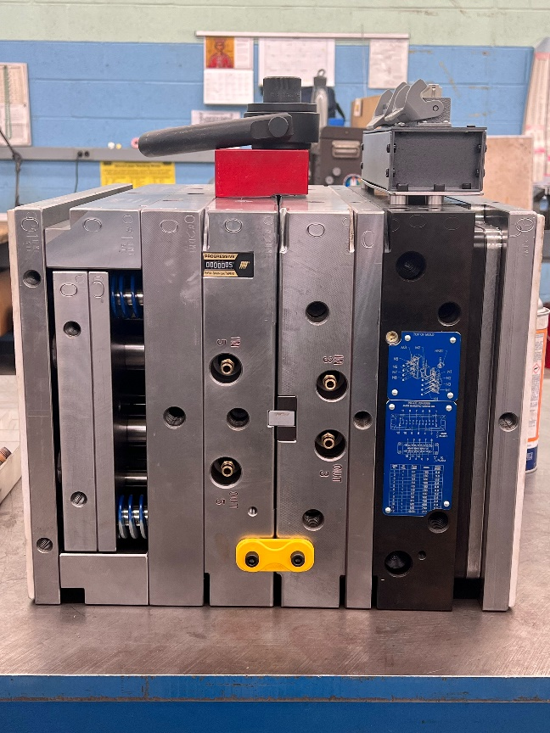

Ejection
Ejector Box
Once molding is complete, the part needs to be ejected from the mold, this is done using the following components:
Ejector housing: This housing includes the ejector plate and pins or sleeves, which allow the part to be removed from the mold.
Ejector plate: This assembly moves forward during the ejection process to assist in part removal
Ejector pin(s) or sleeve(s): These pins or sleeves are used to push parts out of mold.
Ejector Plate
Ejector Pins

Slide 10
Hot Runner & Cold Runner Components
Hot Runner Components
  Manifold: This keeps the plastic molten and acts as the runner system, and does not create a physical runner since it is molten at all times.
  Drops: This is a continuation of manifold, and is a delivery system of molten plastic to the gate.
Cold Runner Components
  Cold runner: the delivery system from the machine nozzle to the gate of the mold
  3 plate cold runner design: brings the gate to back side of the part and separates part from runner during mold open which automatically de-gates the part

Slide 11
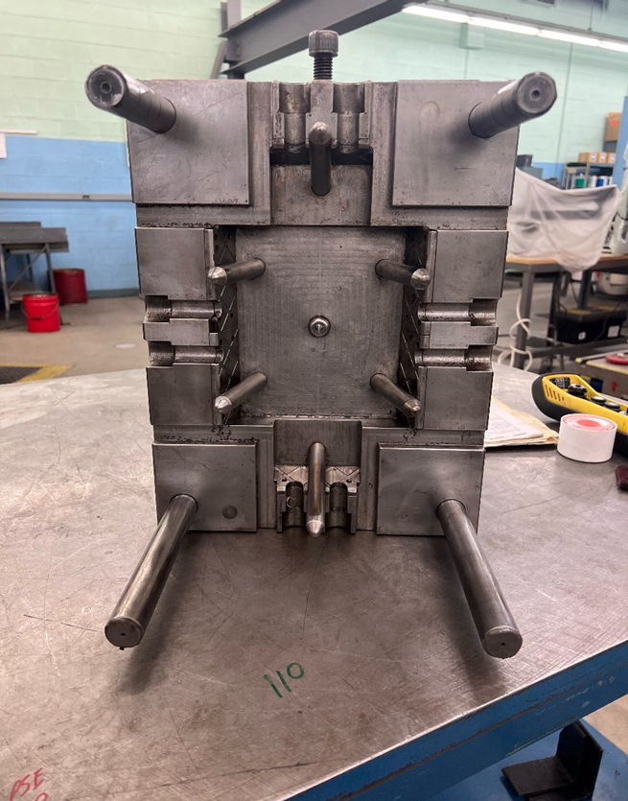

Alignment Components
Leader Pins
  Leader pins: These are large pins on the outside of the mold that help guide the mold halves together
  Bushings: The leader pin goes into the bushing in the opposite side of the mold while it is closing
  Side locks: These keep the mold aligned for a long period of time and creates a more positive alignment, these are placed on the side of the mold
  Top locks: These keep the mold aligned for a long period of time and creates a more positive alignment, these are place on the top of the mold
  Roller locks: These keep the mold aligned for a long period of time and creates a more positive alignment. This type of lock utilizes roller bearings in order to create less friction, they are used for very high volume jobs
  Locating ring: This aligns the tool to the stationary half of the machine to have proper alignment to the injection unit of the machine
  Note: Whether side locks, top locks or roller locks are used on a tool is determined during the design of the mold, and vary based on the restrictions and requirements made by the part
Bushings

Slide 12
Sensors
  To prevent damage to the mold sensors are put in place to protect it during the molding process:
  Reed sensors: These sense where the cylinder rod is at any given time, which sends a message to the machine that tells the machine if it can close or not.
  Vision sensors: This sensor looks for color differences which would determine if a part was stuck in the mold and would tell the machine not to close.
  Proximity switches: These are used to sense action components in a mold to determine their current location for metal components, it is not necessary for the components to make contact
  Dry contact Sensors: Senses any type of material within the mold, it must make physical contact with the sensor in order to determine its position.

Slide 13
Thank you for taking the time to review our mold components slide deck! If you have any questions or need a quote, please contact sales@jacomfg.com

